Slide 1
PRESENTATION BY, RAHUL KUMAR NAKUL AGARWAL HARSHITHA S AASTHA RAI MANISH JAISHWAL
TRAIN TICKET
RESERVATION SYSTEM

Slide 2
CONTENTS
PROBLEM STATEMENT
DESCRIPTION
DESIGN /ARCHITECTURE
TECHNOLOGIES USED
SNAPSHOTS

Slide 3
PROBLEM STATEMENT
This Application involves generating a train ticket and printing the ticket to a file
The application should take train number and passenger details as input.

Slide 4
DESCRIPTION
The main aim of the application is that provides a functionality to passengers to view the trains and can update their personal details to book the tickets by themselves.
The Home page contains User Login, User Registration, Admin Login ,Train options, Ticket options ,describes about other services available in the application, clients and description about the application.
The user can Register or login to his/her account to view ,book ticket and can download the ticket.
The Admin can add, view, update, delete trains.

Slide 5
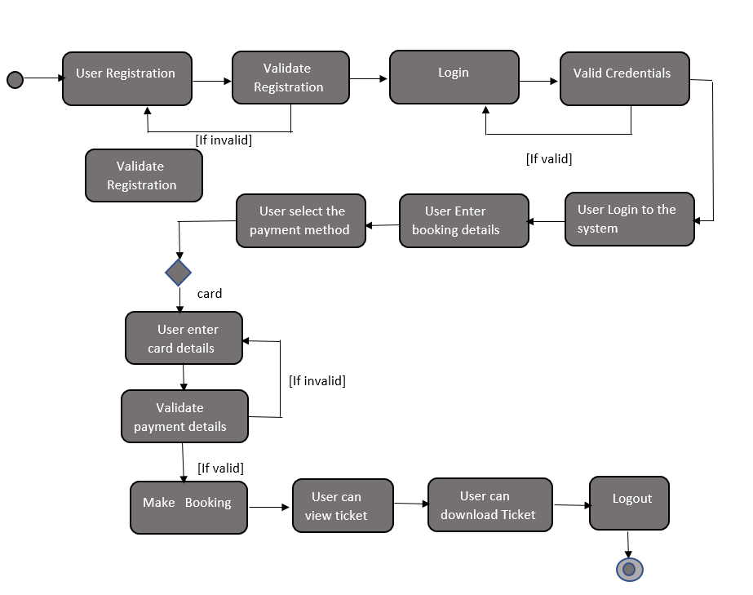
SYSTEM DESIGN

Slide 6
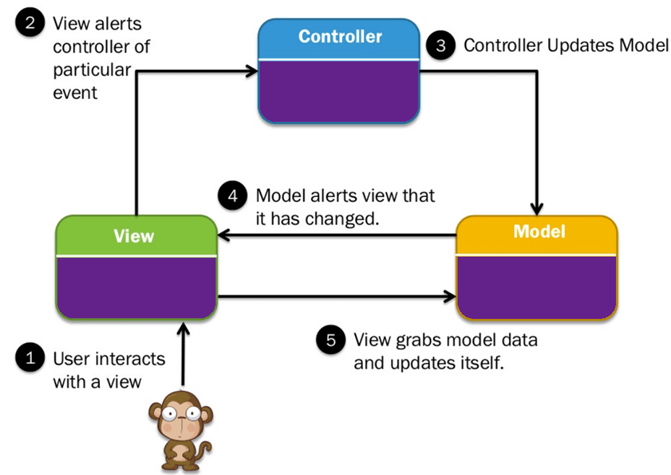
MVC ARCHITECTURE

Slide 7

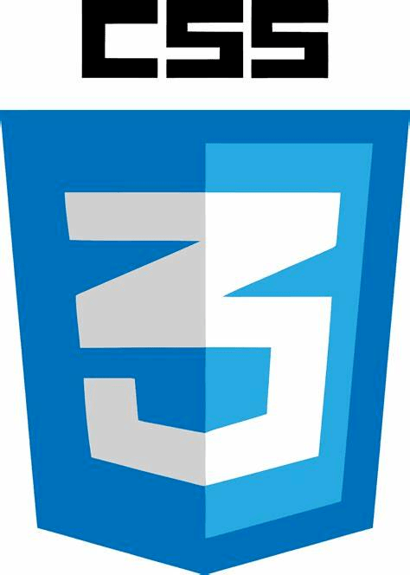




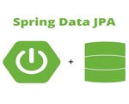

TECHNOLOGIES USED

Slide 8
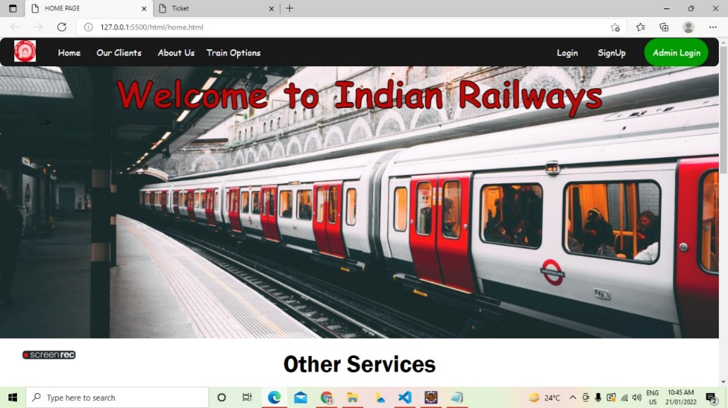
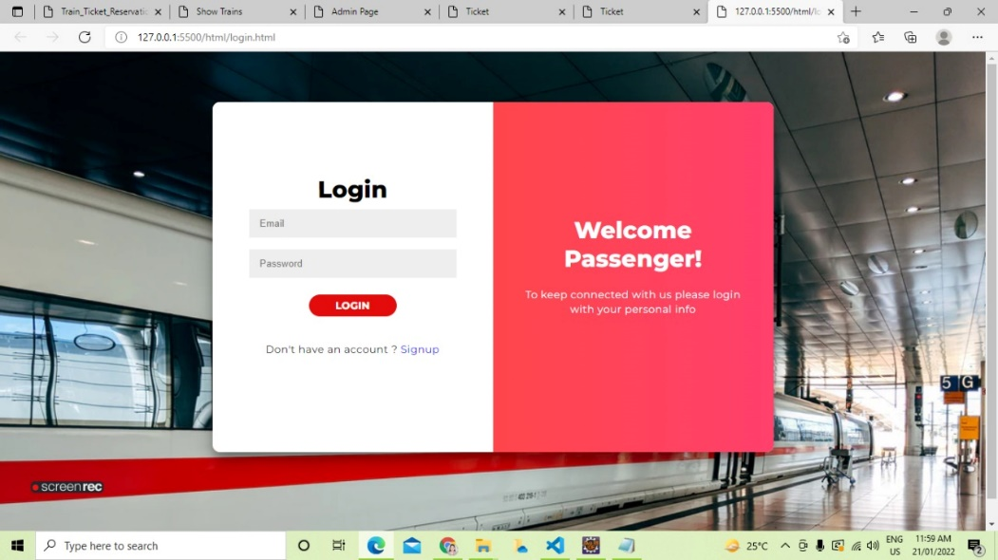
SNAPSHOTS
LOGIN PAGE
HOME PAGE

Slide 9
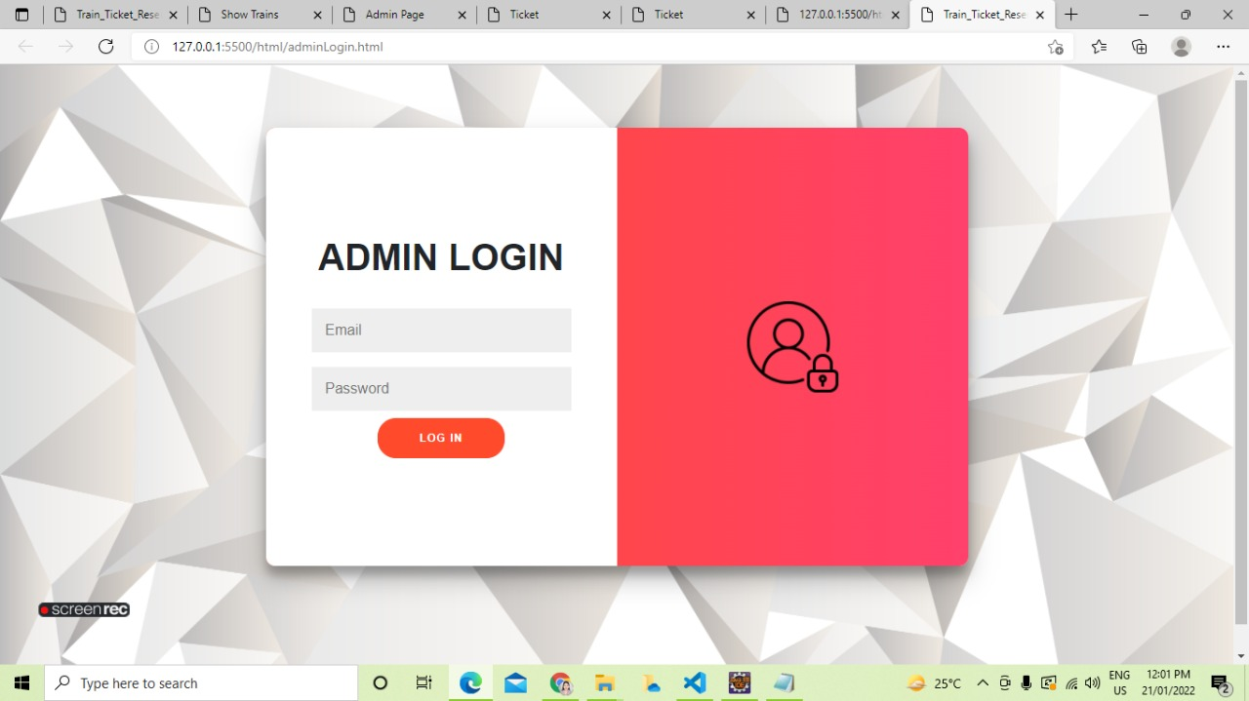
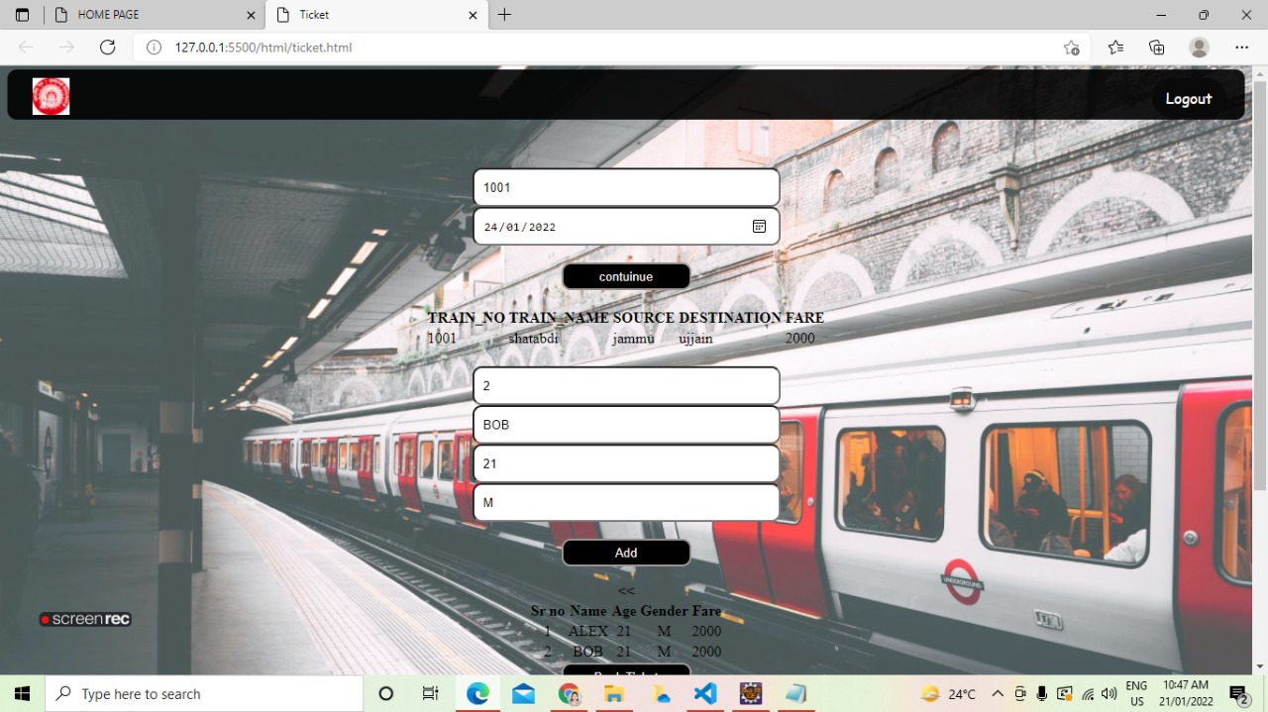
TICKET BOOKING PAGE
ADMIN LOGIN PAGE

Slide 10
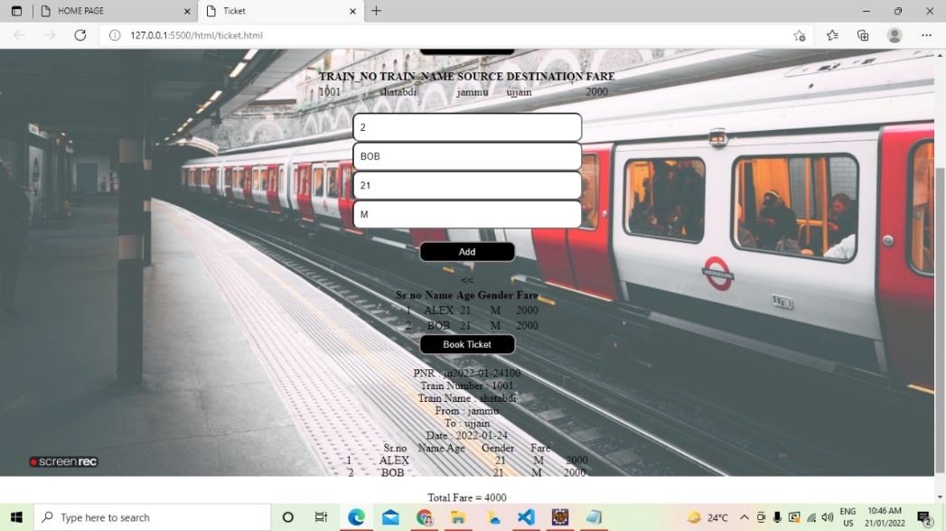
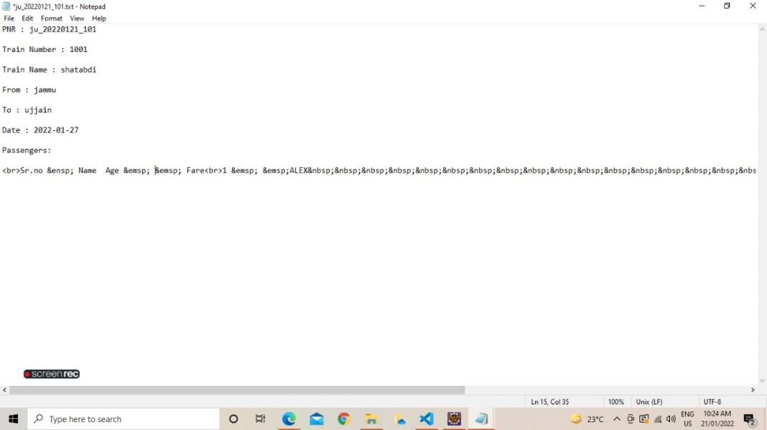
DOWNLOADED TICKET

Slide 11
THANK YOU

